Slide 1

Culverts Rehabilitation with Concrete Cloth

Slide 2
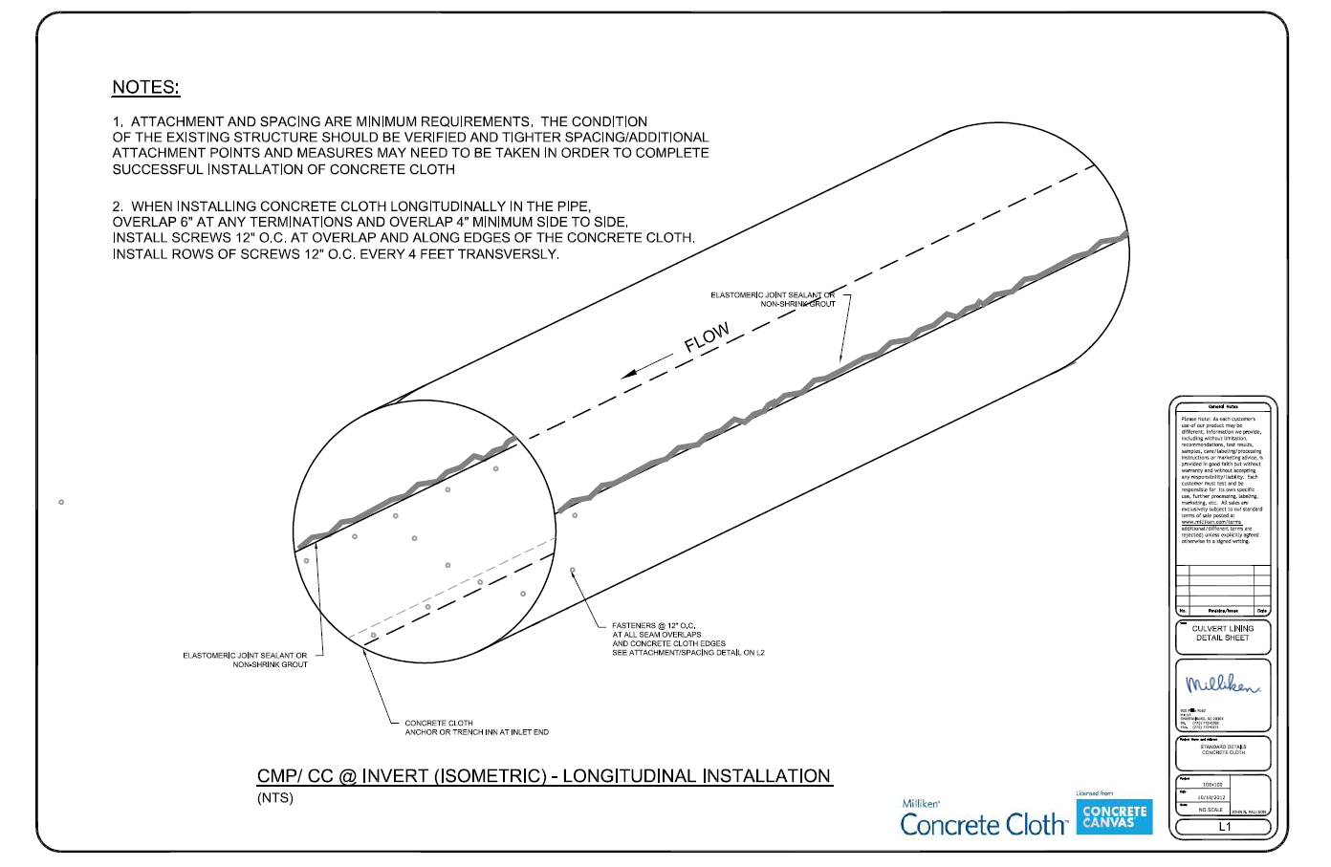
Culvert Lining Detail – Installation Detail Longitudinal

Slide 3
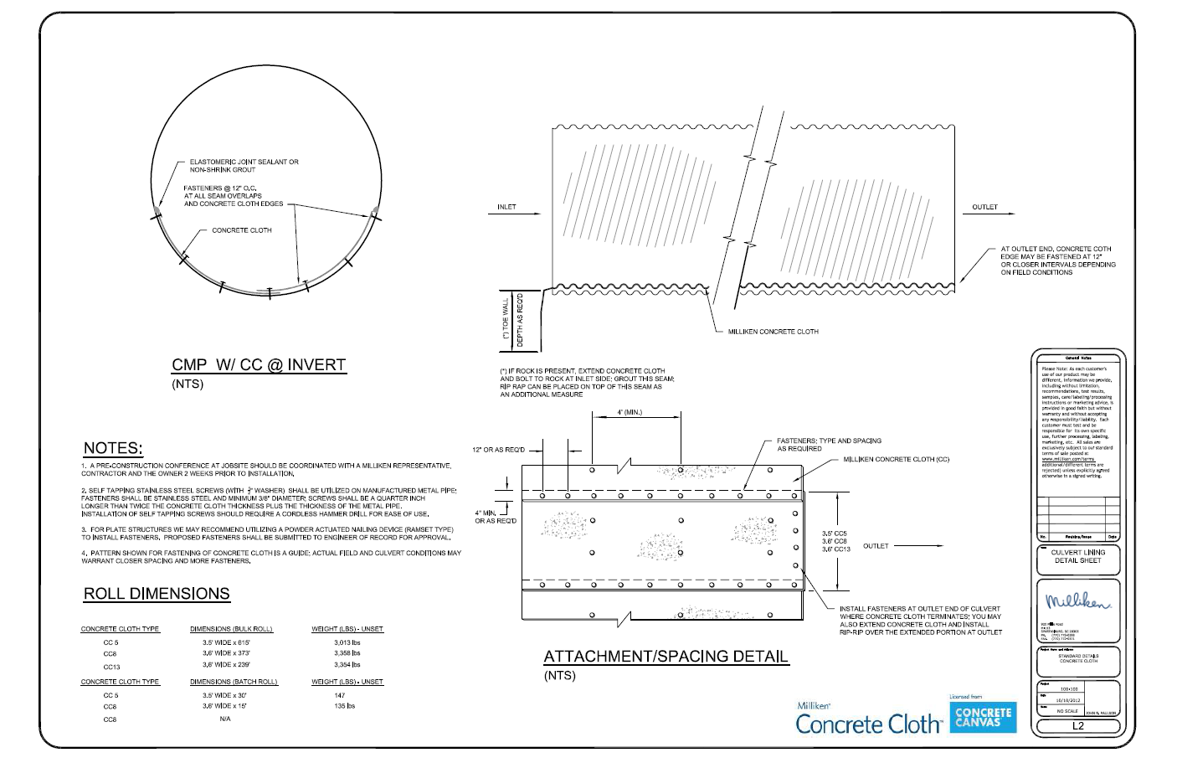
Culvert Lining Detail – Installation Detail Longitudinal

Slide 4
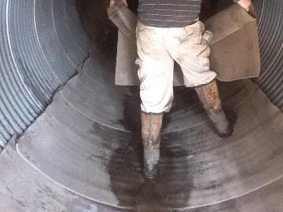
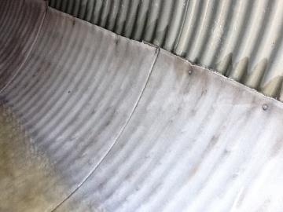
Concrete Cloth Case Study: Greenville, AL
After ensuring that the invert was still structurally intact, the Concrete Cloth was cut and laid in a shingled fashion in direction of the flow. Along the edges, screws are used to attached the Concrete Cloth to the pipe.

Slide 5
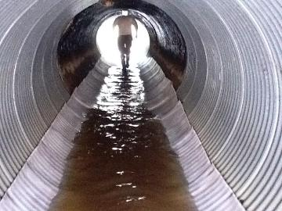
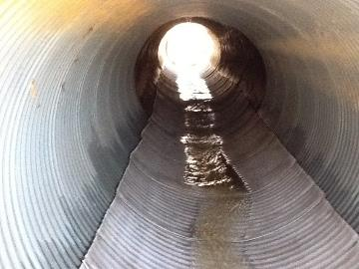
Concrete Cloth Case Study: Greenville, AL
Flow was released to allow the water to act as the hydration method. Concrete Cloth cannot be overhydrated.

Slide 6
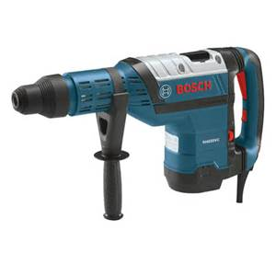
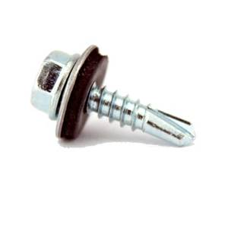
Securing Concrete Cloth to a (CMP - manufactured pipe)
Self Tapping Stainless Steel Screw 1.25” long for CC8 lining
Hammer Drill

Slide 7
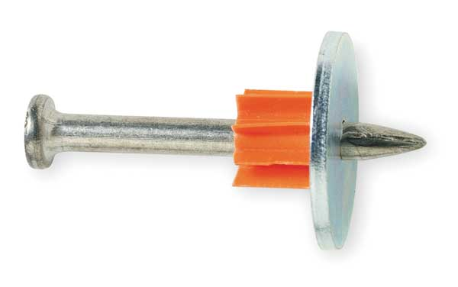
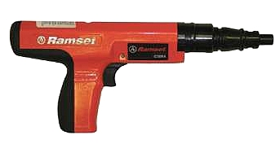
Culvert Lining Installation (Steel Multi-Plate)
Powder Actuated Gun
Powder Actutated Fastener w/Washer

Slide 8
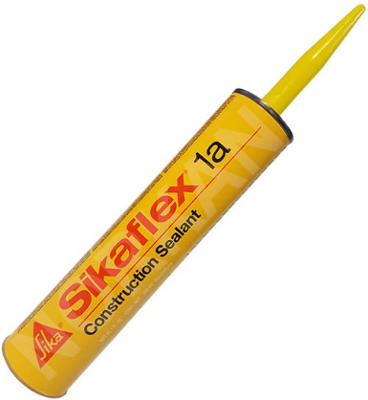
Culvert Lining Installation (Edge Sealant)
Bituminous
Elastomeric Sealant

Slide 9
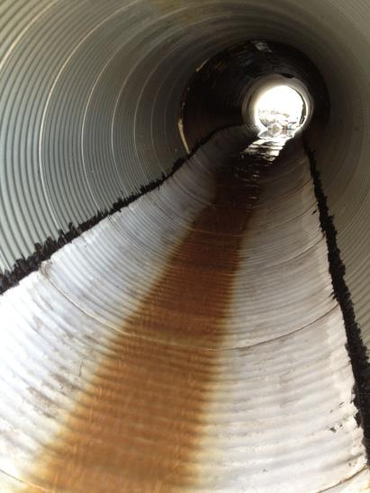
Concrete Cloth Case Study: Greenville, AL
After the Concrete Cloth had cured overnight, the top edge of the installation was sealed with tar to limit high water infiltration.
M
A

Slide 10
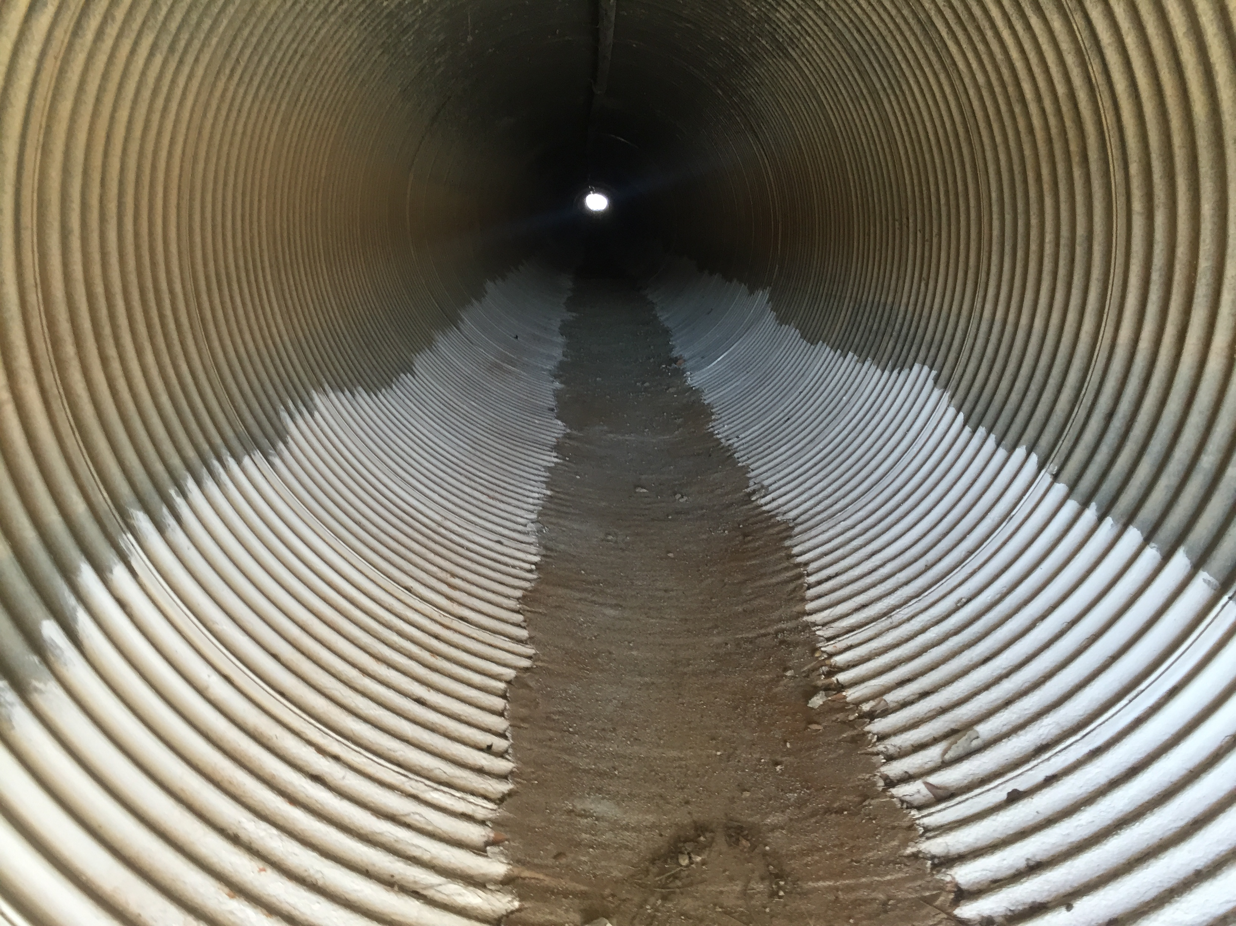
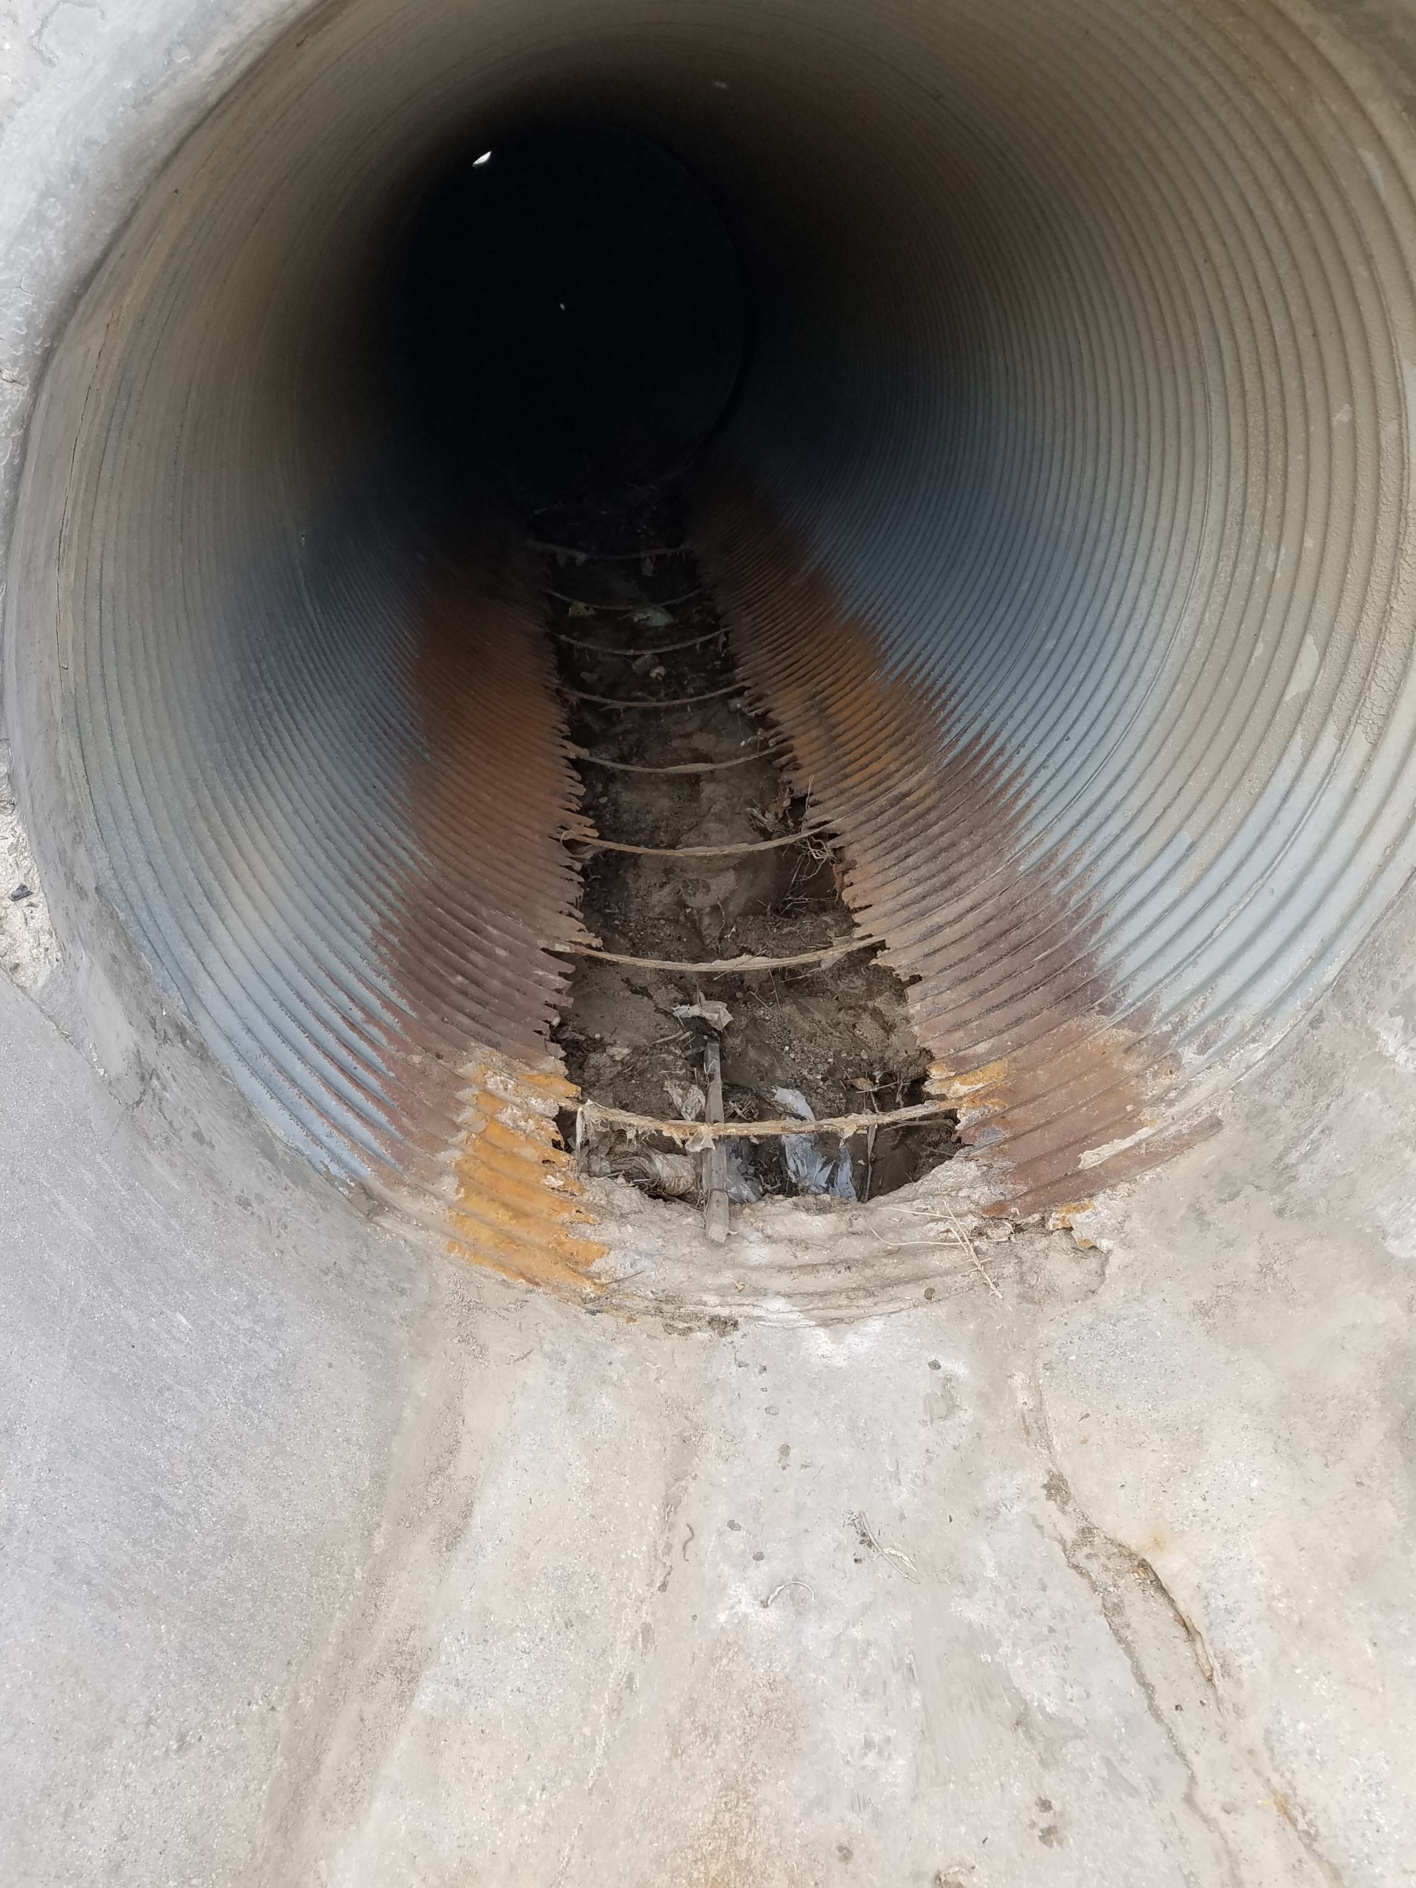
2 – 60 inch culverts 200 ft long in need of repairs before winter storms
After Cleaning culvert
Poured concrete and rust prohibitory

Slide 11
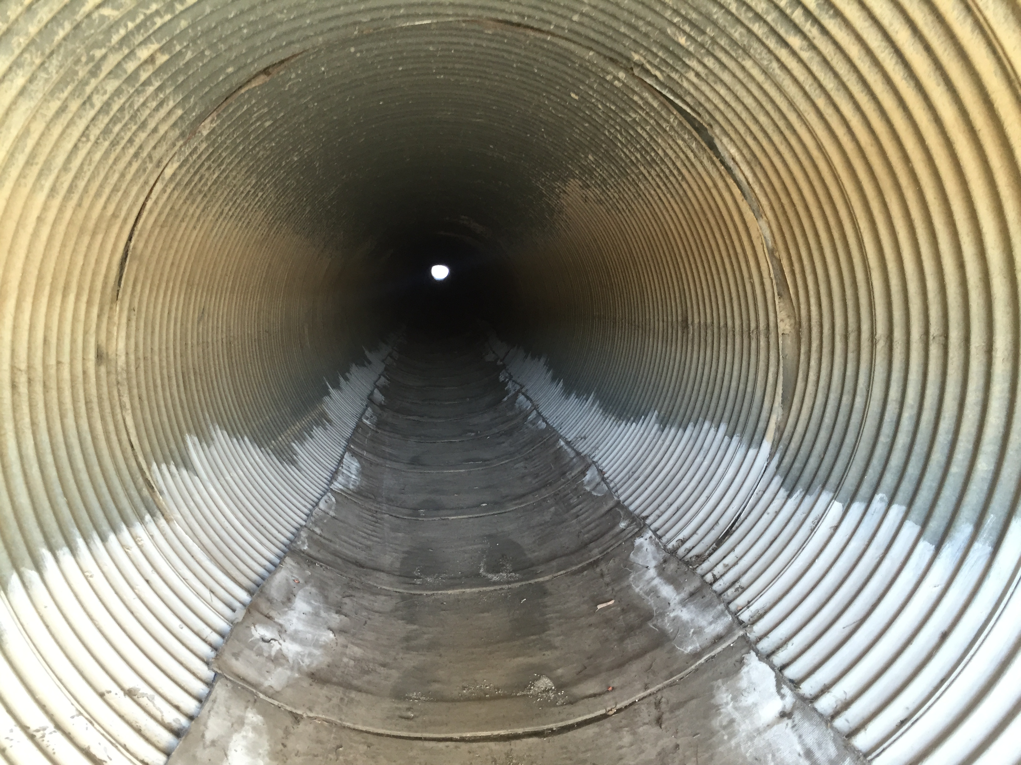
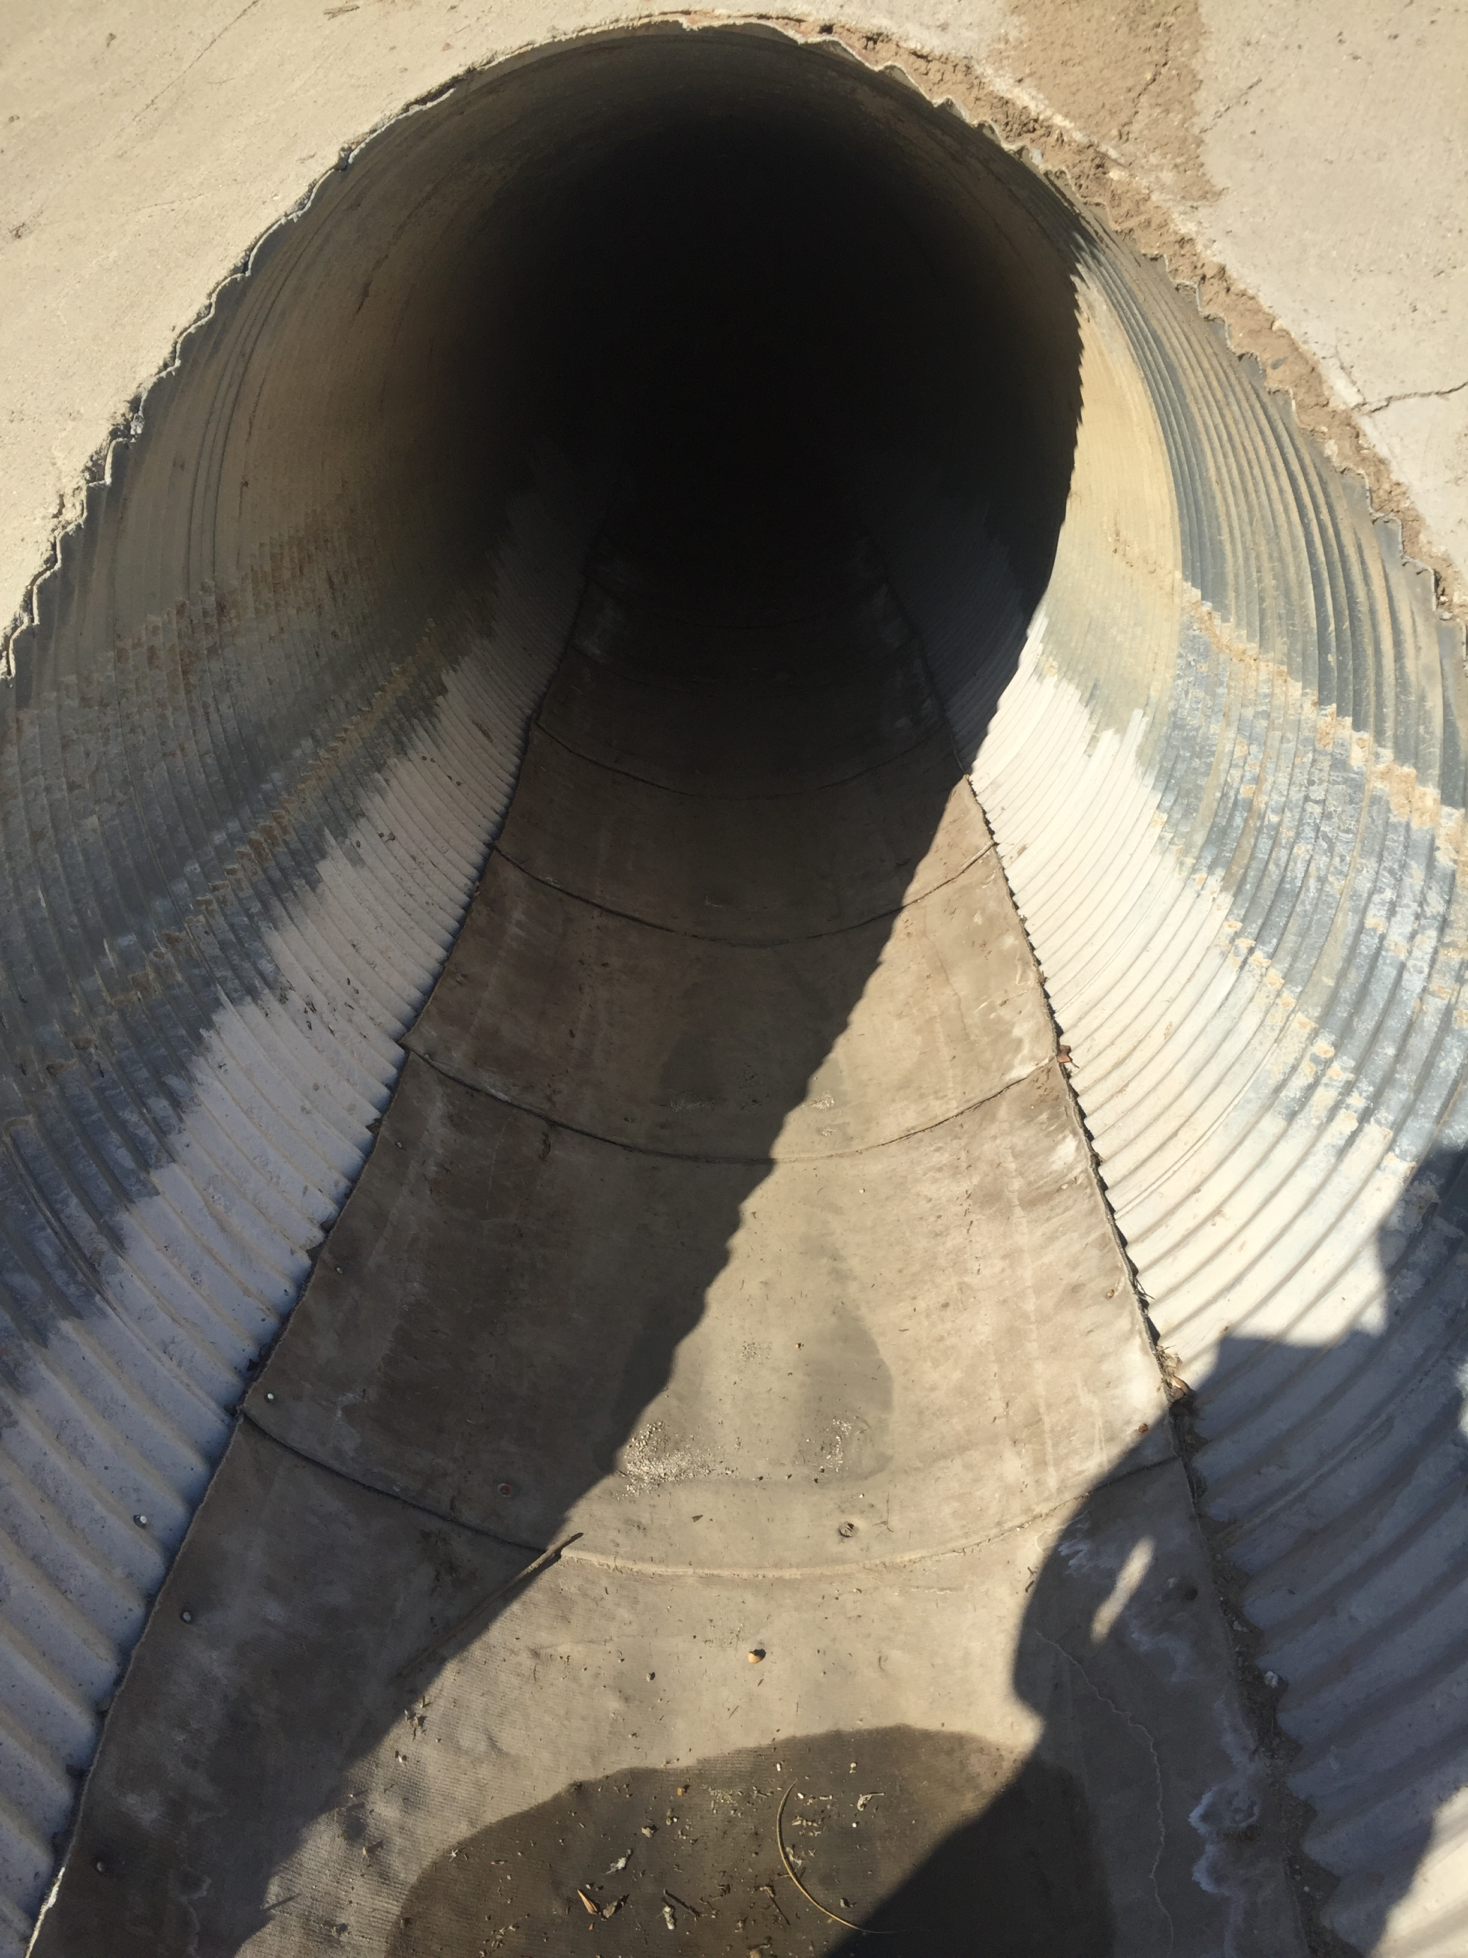
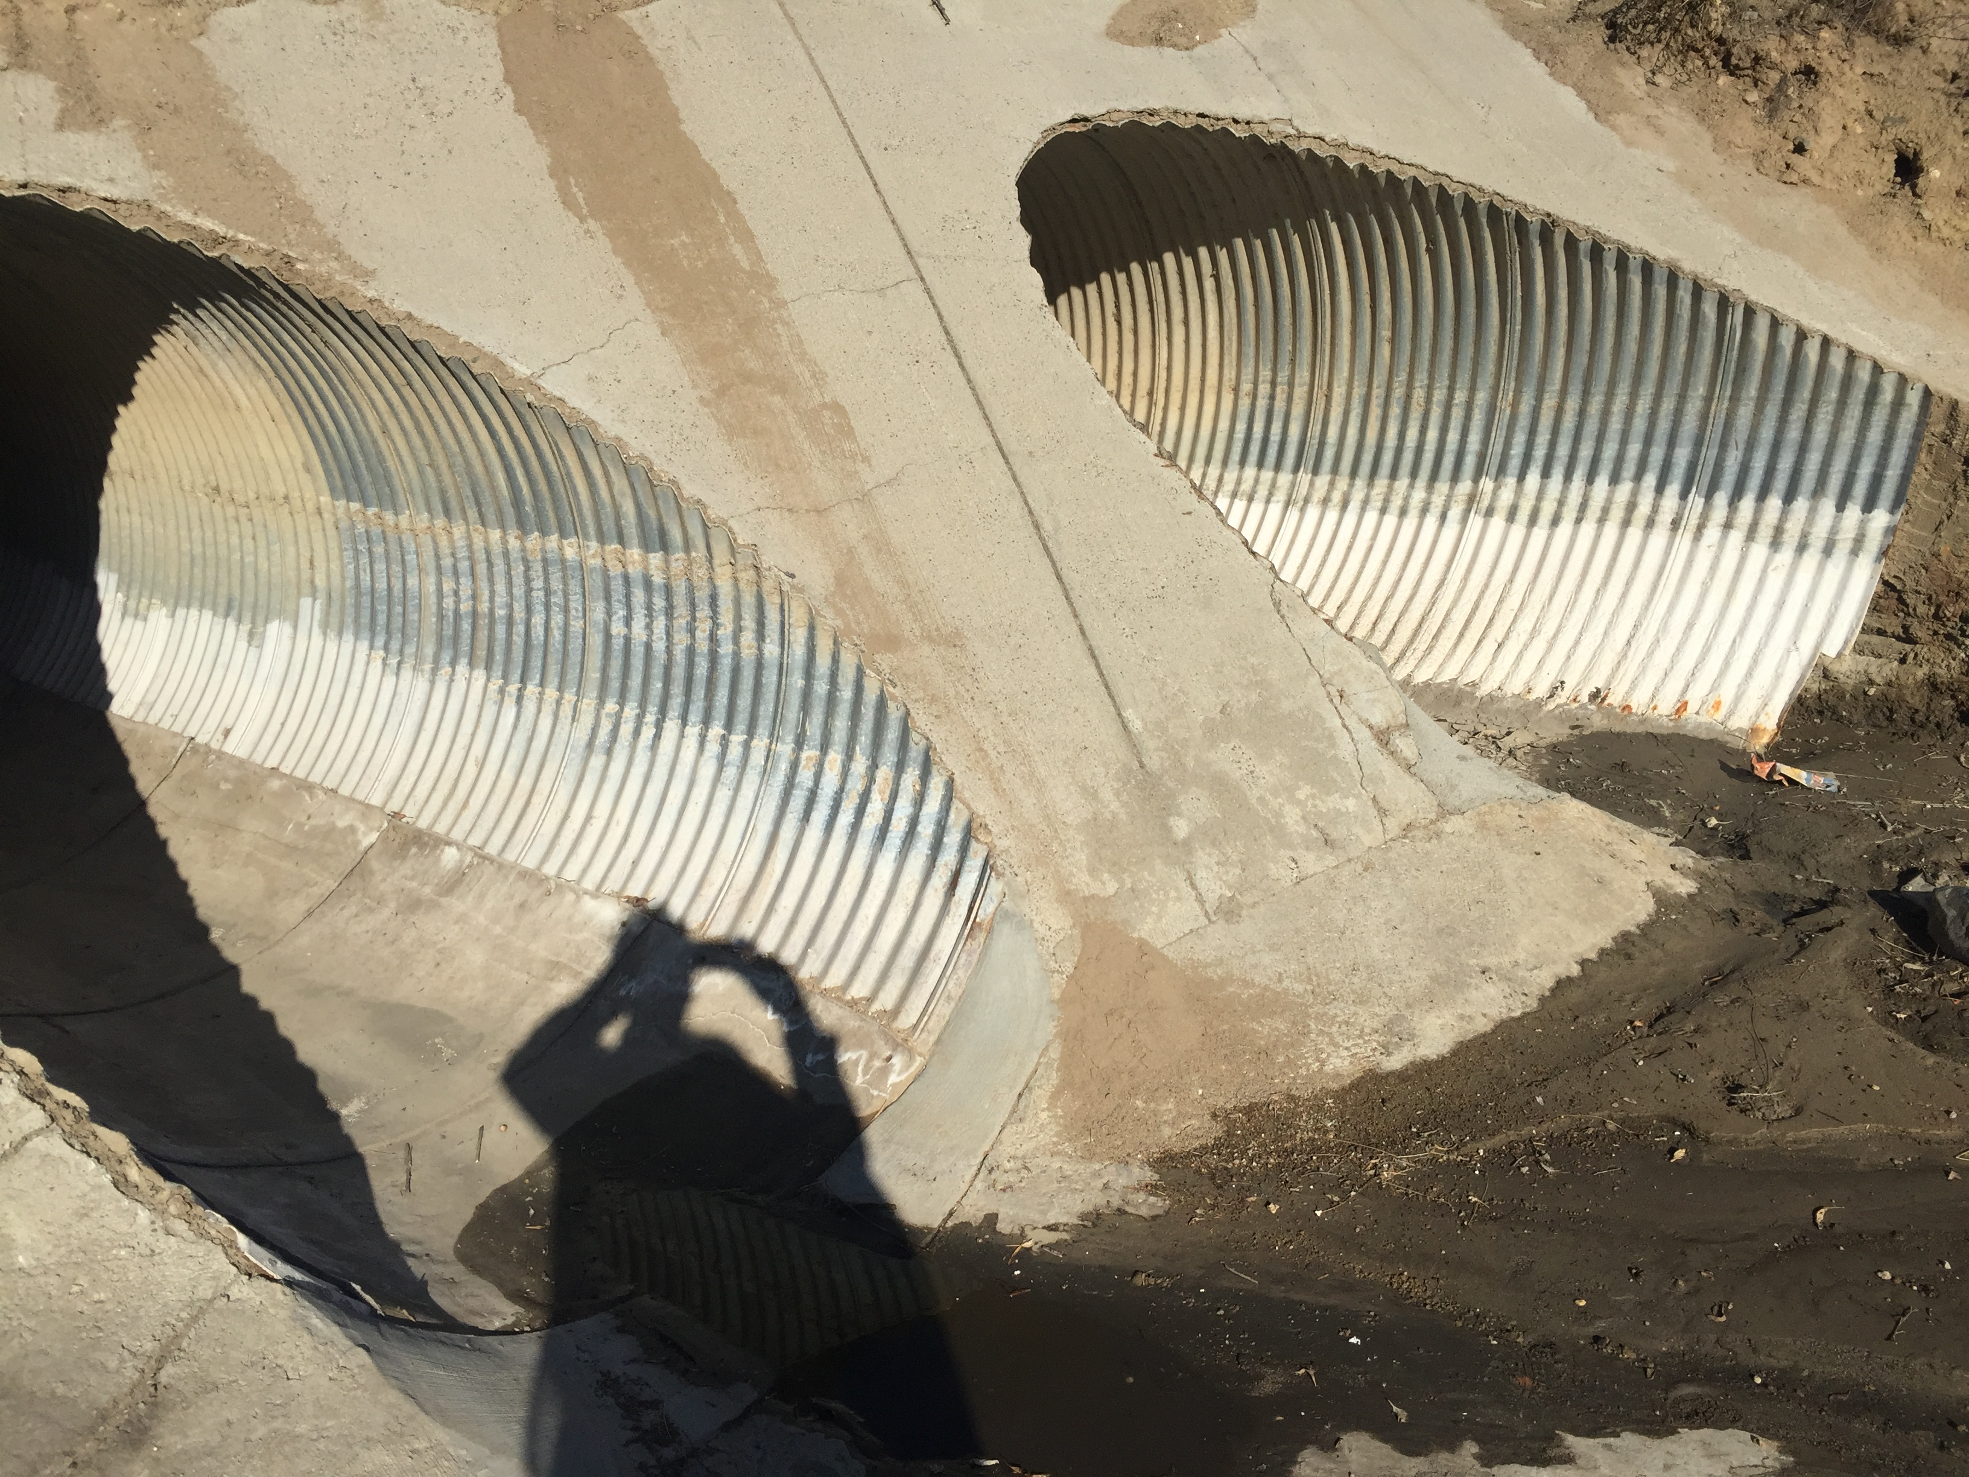
Concrete Cloth Installed

